Slide 1
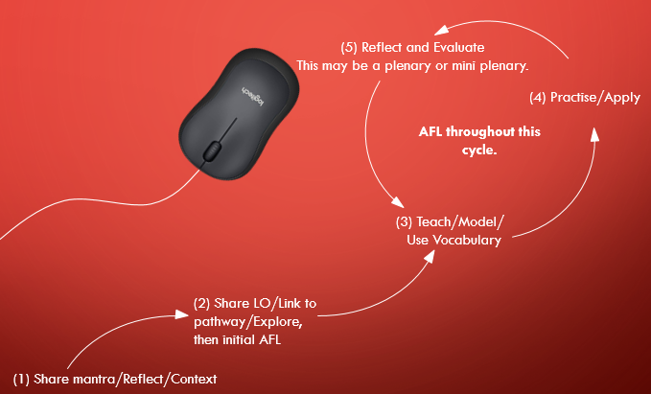
How a Computing Unit should look…
Components from each lesson in a unit come together to create a composite e.g. a completed application or document.

